Slide 1

Interaction STUDIO
Ganesh Varma

Slide 2
What is personalization
Marketing Cloud Personalization is a solution that enables companies to deliver contextually relevant experiences in real-time across their channels. Marketing Cloud Personalization reacts to the real-time behavior of consumers as they interact with a brand’s owned channels, including online through email, social, and mobile, and offline via in-store or kiosks.
With Marketing Cloud Personalization, marketers can:
Automate AI-driven customer journeys: Create, automate, and manage intelligent, always-on customer journeys that learn as they go.
Create personalized web experiences: Optimize a brand’s website with dynamic content to cater to each customer’s needs in real-time.
Connect journeys across channels: Engage your customers across the web, email, call centers, and more. Send messages based on browsing history, purchase history, or when a product is back in stock.
Make real-time offers that drive conversions: Use in-the-moment data to deliver engaging product and content offers across your marketing.

Slide 3

Website Configuration

Slide 4
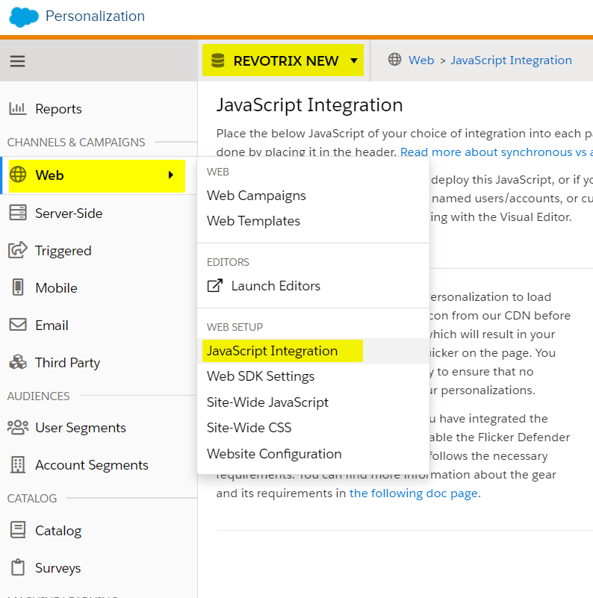
Site mapping before we need to install: 1. Salesforce Interactions SDK Launcher / Beacon Installation Steps / Web SDK 2. On the dashboard of the selected dataset go to Web -> JavaScript Integration, select the synchronous tab, and copy the JavaScript integration beacon script to deploy on the website.
Site Mapping

Slide 5
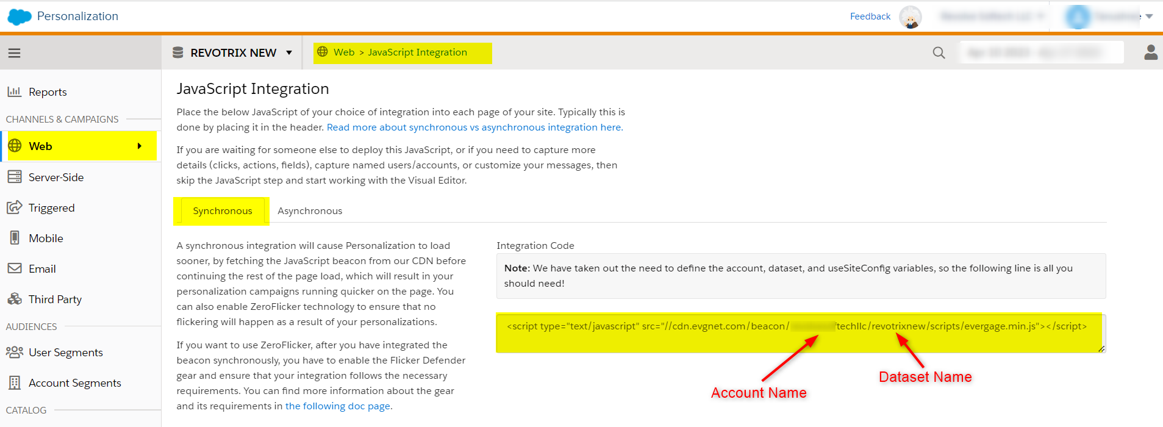

Slide 6
Beacon script
Below we have a Beacon script example to be deployed in the head tag of the webpage (you can ask your web developer to do it on the staging/dev environment of the website before you are ready for PROD)For example:
<head> <script type=”text/javascript” src=”//cdn.evgnet.com/beacon/myaccount/mydataset/scripts/evergage.min.js”> </script> </head>

Slide 7
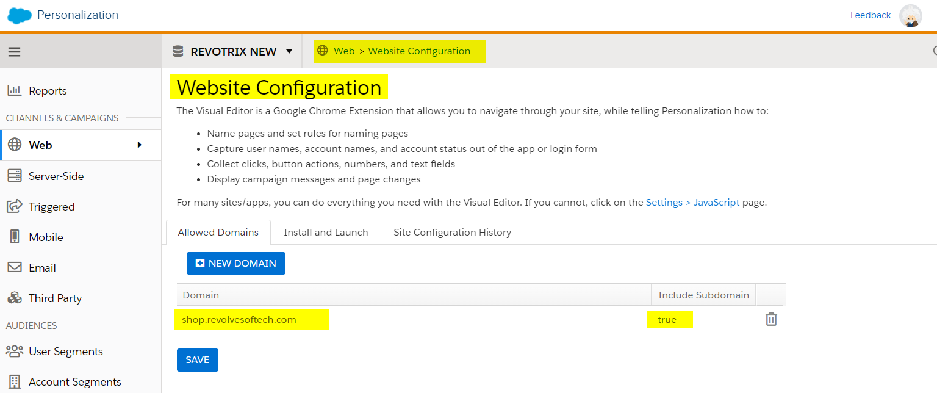
In Personalization, we need to configure Website Configuration in the Web tab.

Slide 8
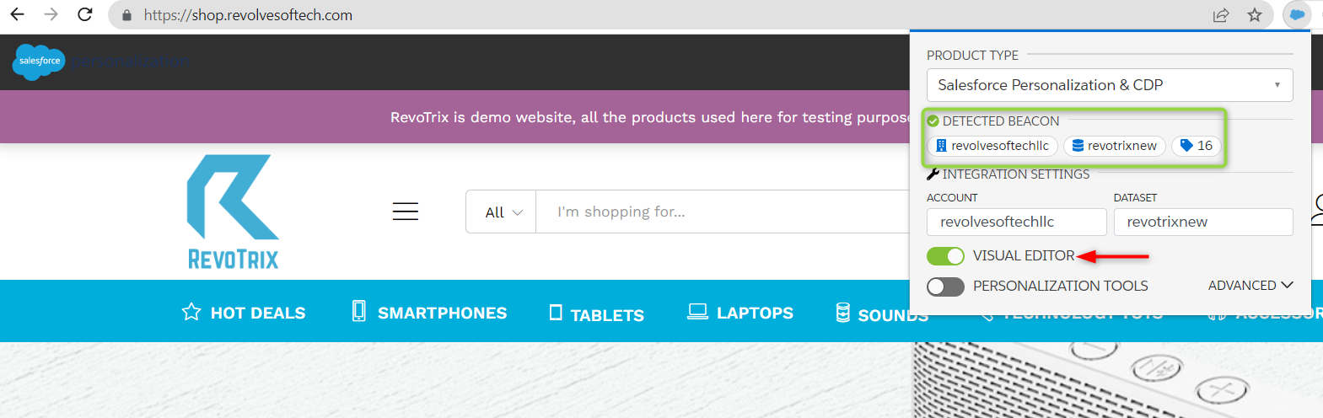
Once the browser extension displays the desired account and dataset in the “Detected Beacon” section of the browser extension window, you will be able to activate the Visual Editor.

Slide 9
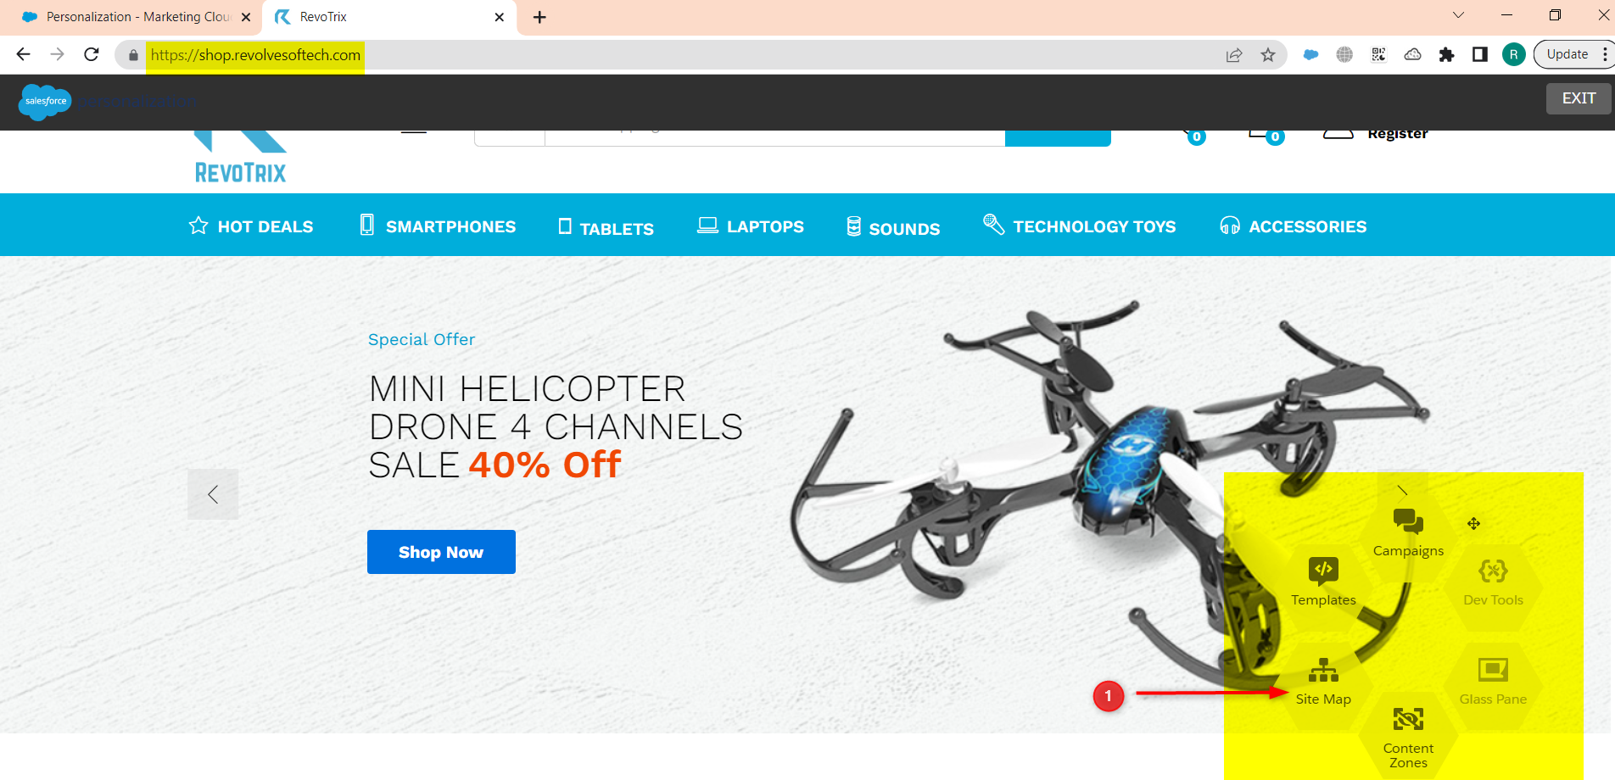
The following functionalities we can create in the visual editor:- Campaign, Templates, Sitemap, Content Zones, etc.
For Sitemap, click on the sitemap icon (1) seen in the screenshot, we will get a code editor to write and test JavaScript code.

Slide 10
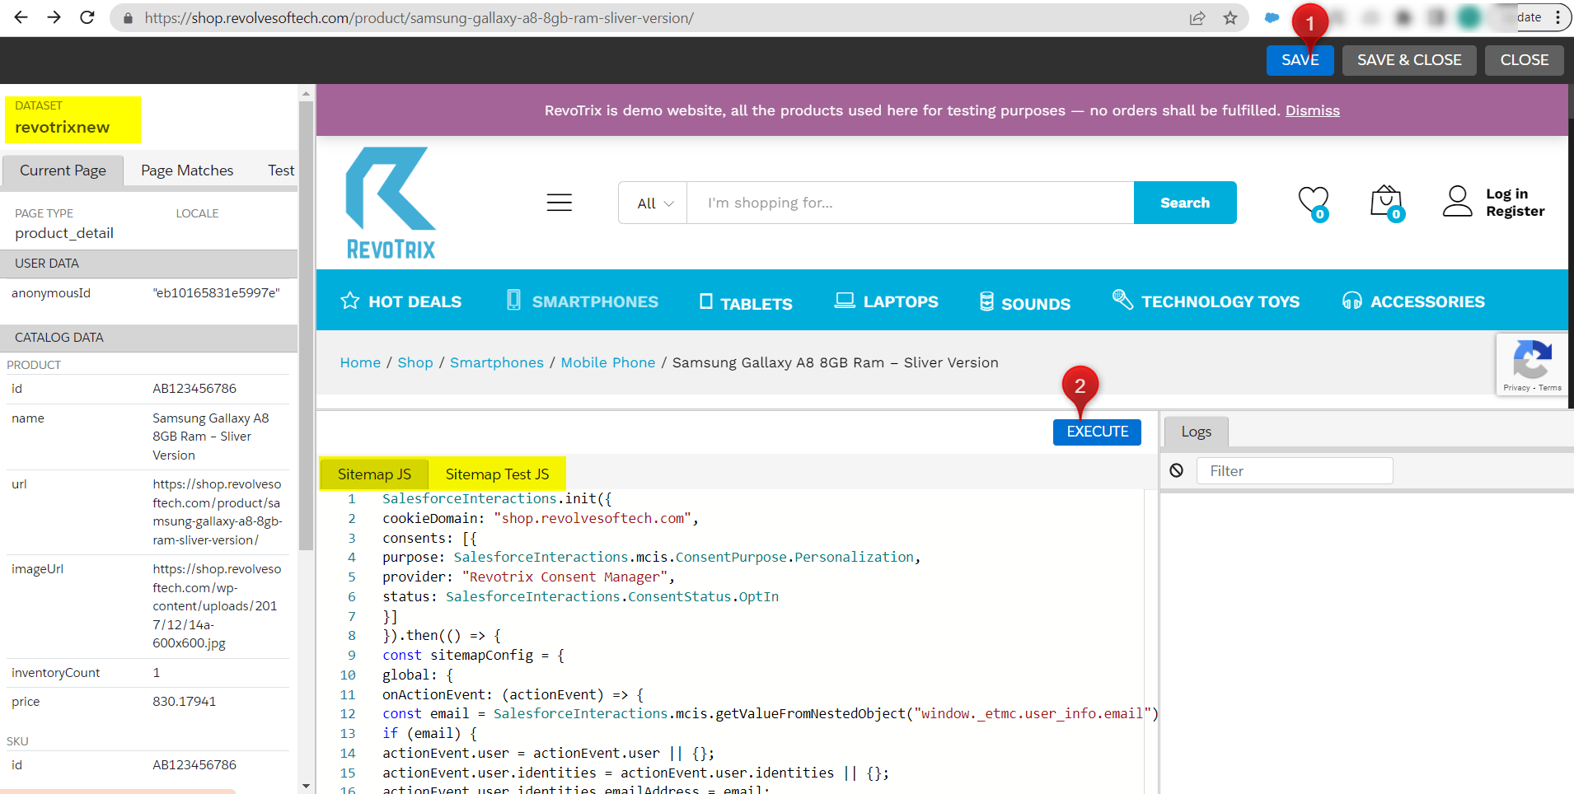
After configuring the sitemap click on the Save (1) and Execute (2) buttons, on the left side we can see the visual results of data streaming from the website which will be stored in the product catalog of personalization.

Slide 11



